Slide 1
What’s Brewing around
REST for Telco
Peter Yeung
Elena Fersman
Ericsson Developer Connection

Slide 2
Agenda
The things you probably already know...
...and the REST
REST in use
Mash-up – combining services
Demo
  Demo 1
  Demo 2
  Demo 3
  Demo 4
Developer Strategy
Behind the scenes
Q&A

Slide 3
The things you probably already know...
Computer to computer communication
  Different interfaces and protocols
Human to computer communication
  User interface
Communication on the Web
  From the server to the human
  The HTTP protocol
  The web browser (Internet Explorer, Firefox, Opera, Safari etc.)

Slide 4
...and the REST
Representational state stransfer (REST)
Dynamic and interactive content on web pages
  Reusing existing services – why build a new map service when I can use Google’s service?
  Combining services (mash-ups)
A need to communicate between browsers and servers with those services
The term REST is often used loosely to describe a simple interface for communication over HTTP
HTTP is already known by the large mass of web developers

Slide 5
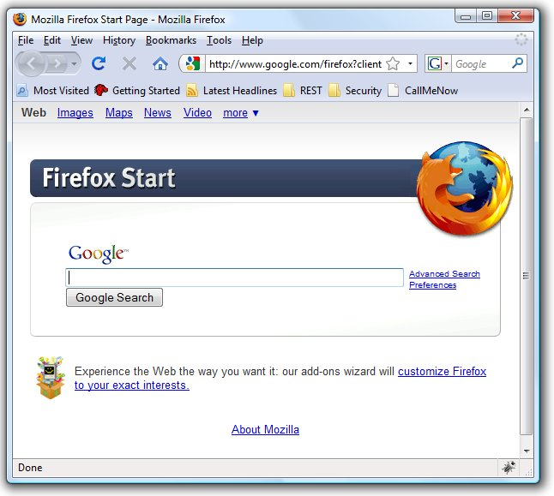
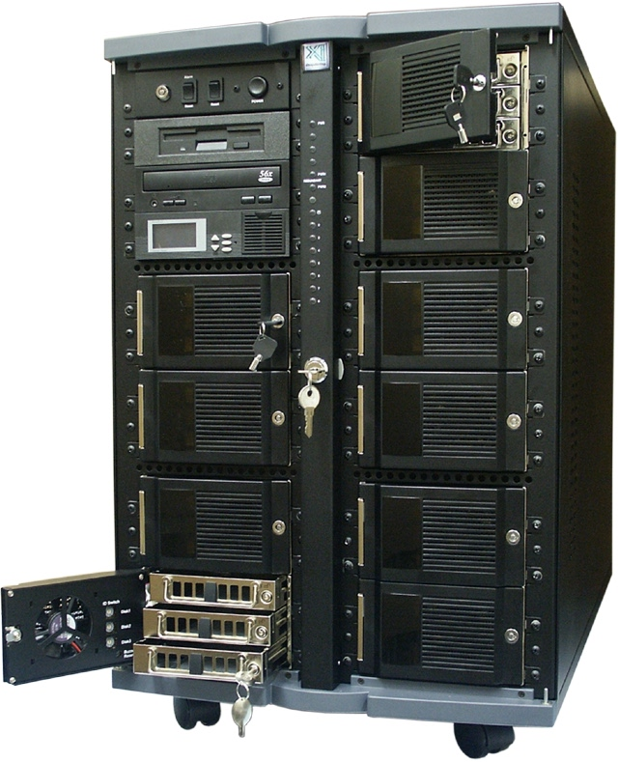
REST in use
REST client
REST server
HTTP

Slide 6


Mash-up – combining services
Display all of your friends on a Map
Display friends
Web server
REST server
Geocoder service
REST client
REST server
Maps
service
Proxy-style REST
Client-style REST

Slide 7
Our goal
To target the large amount of end-users on Internet by offering them Telco capabilities via client-style REST

Slide 8
REST Use Cases
Demo1: Pure HTML:
  Redirect Client style
Demo2: Javascript/DHTM:
  Direct Client style
Demo3: Desktop Widget:
  Proxy/Client style
Demo4: Thin fat client:
  JavaFX+Direct Client style

Slide 9

Call Me Now service
“Call Me Now” Service example
showing 3rd party call capability
Based on REST HTTP GET URL:
http://callmenow.kicks-ass.net/callA? clientA=070243528 & username=peter.yeung

Slide 10
Time for some demo....

Slide 11
Demo1 – REST Client redirect style
This demo shows how easy a user can add a “Call Me Now” capabilities on any internet Blog, this demo shows it with http://blogg.se/
The blog web site have nothing with the operator todo i.e. the new business are user driven/pushed.
The REST client redirect style shows how easy a user can add 3 lines of common HTML without using any Javascript.

Slide 12
Demo2 – REST Client direct style
This demo shows how easy a user can add a “Call Me Now”
Better user experience

Slide 13
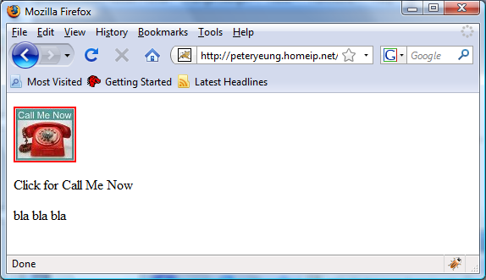
A simple static HTML page

Slide 14
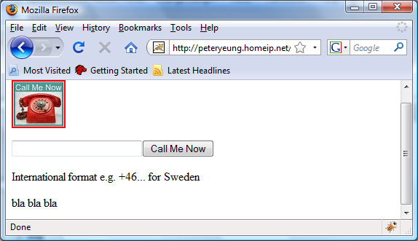
Dynamic HTML tags is generated after click on the image

Slide 15
User only need to past 3 rows of common HTML code for user customized design
<script type="text/javascript" src=“***/CallMeNow.js"></script>
<a href="#h" onclick="showCall('callMeNowId')"><img src=“***"/></a>
<div id="callMeNowId">Click for Call Me Now</div>

Slide 16
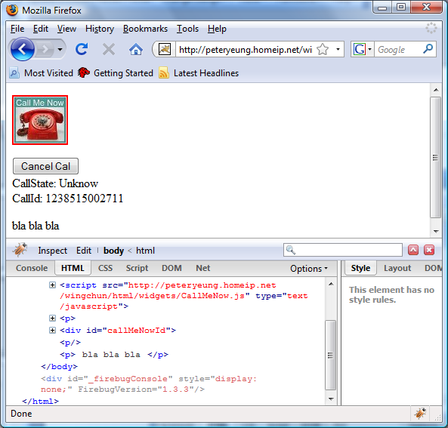
Call id is returned back with polling of call state

Slide 17
Developer Strategy

Slide 18

Exposing Telecom capabilities/services evolution
User designed services &
User generated content
User
Driven
REST – client-style, redirect-style
Internet & web applications
REST/RESTful ws – HTTP, proxy-style
IT
Developer
Driven
Parlay X – SOAP
Parlay OSA – Corba IIOP, distrubueted computing
Walled garden
Telco
Expert
Driven
IN – e.g. SS7, AXE etc.
digitalization

Slide 19
Strategy Background
Enabling for User Designed Service for User Generated Content
Independent
No relation between blogs or web provider with the operator
No hard Integration with the telco capability
Works everywhere
Works in non dynamic Web pages in e.g. web hotels
Easy to work with GCI e.g. ASP.NET, JSP, PHP, RUBY etc.
(i.e. light integration on presentation layer)

Slide 20
The REST Strategy
Summary for the “REST for next generation Telco” strategy:
For increase the use of the Operator capability assets,
Make it available for the Web 2.0 by:
  Independency with Web Service Provider & Community provider
  user driven
  Lose coupling with users/developers
Target the mass:
Long tail of user generated web content/service
Long tail of web developers

Slide 21
Behind the scenes

Slide 22



Physical Deployment architecture
User design service & generated content
Independent
Web Server
Hosted by Peters HomePC at home
Mini ISB SIG
WebCall
REST
GateWay
WebCall
Application
CallMeNow
Proxy
SOP restriction
REST
SOAP
SIP
PSTN
Broker
Direct Client Style
Redirect Client Style
Mobile
Front
Controller
Mobile
Front
Controller
Proxy Style REST
Wing Chun
Community
application
Mobile
Front
Controller

Slide 23
Same Origin Policy (SOP)
Problem:
Restriction of cross-domain references from Javascript in browsers (Demo2) due to security reasons
Consequence:
AJAX cannot be used because
  Web Page comes from one web server domain (e.g. blogg.se)
  REST interface is from another domain (e.g. telco.com)
Solution:
Dynamic Script Src + JSONP (REST direct client style)
  Based on DHTML

Slide 24
Q&A

Slide 25
Function showCall() is invoked
function showCall (id)
{
callMeNowId = id;
var formElement = document.createElement('form');
formElement.setAttribute('method', 'POST');
formElement.setAttribute('name', 'formName');
formElement.setAttribute('action', '#');
var inputElementNumber = document.createElement('input');
inputElementNumber.setAttribute('name', 'clientA');
inputElementNumber.setAttribute('id', 'clientA');
inputElementNumber.setAttribute('type', 'text');
inputElementNumber.setAttribute('value', '');
inputElementNumber.setAttribute('size', '25');
var inputElementCall = document.createElement('input');
inputElementCall.setAttribute('name', 'CallSubmit');
inputElementCall.setAttribute('onclick', 'doCall()');
inputElementCall.setAttribute('type', 'submit');
inputElementCall.setAttribute('value', 'Call Me Now');
formElement.appendChild(inputElementNumber);
formElement.appendChild(inputElementCall);
var callMeNowDiv = document.getElementById(id);
removeChildNodes(id);
callMeNowDiv.appendChild(formElement);
callMeNowDiv.appendChild(document.createTextNode("International format e.g. +46... for Sweden"));
}

Slide 26
function showCallResult invoked via JSONP
function showCallResult (id)
{
// DIV id getStateID
var divElementGetStateID = document.createElement('div');
divElementGetStateID.setAttribute('id', stateDivId);
divElementGetStateID.appendChild(document.createTextNode("Connecting..."));
// DIV id callID
var divElementCallID = document.createElement('div');
divElementCallID.setAttribute('id', callDivId);
divElementCallID.appendChild(document.createTextNode("Connecting..."));
// <input type="button" value="Cancel Call" onclick="doCancelCall()"/>
var inputElement = document.createElement('input');
inputElement.setAttribute('type', 'button');
inputElement.setAttribute('value', 'Cancel Cal');
inputElement.setAttribute('onclick', 'doCancelCall()');
// compose
var callMeNowDiv = document.getElementById(id);
removeChildNodes(id);
callMeNowDiv.appendChild(inputElement);
callMeNowDiv.appendChild(divElementGetStateID);
callMeNowDiv.appendChild(divElementCallID);
}

Slide 27
AJAX vs Dynamic Scrip SRC
Both can be used for Web client Technology for polling
AJAX is restricted with Same Origin Policy (SOP)
Dynamic Script src is not restricted to SOP

Slide 28
AJAX based on XHR (Xml Http Request)
function ajaxGet(url, contentType, callbackFunction) {
var xmlHttpRequest = createXMLHttpRequest();
xmlHttpRequest.open("GET", url, true);
xmlHttpRequest.setRequestHeader("Content-Type", contentType);
// make sure the result isn't cached
xmlHttpRequest.setRequestHeader("If-Modified-Since", new Date(0));
xmlHttpRequest.onreadystatechange = function() {
if (xmlHttpRequest.readyState == 4 && xmlHttpRequest.status == 200) {
if (contentType == "text/xml") {
callbackFunction(xmlHttpRequest.responseXML);
} else {
callbackFunction(xmlHttpRequest.responseText);
}
}
};
xmlHttpRequest.send(null);
}

Slide 29
Dynamic Scrip Src with JSONP
Uses JSONP (JSON Padding) for callbacks
Uses DOM/Java Script for create Script node
function checkStateCreateJsonpReq (callbackFunction) {
var script =document.createElement("script");
script.id = 'jsonp';
script.src = 'http://127.0.0.1/ajax/jsonp.json?'+'callbackFunction='+callbackFunction;
script.type = 'application/javascript';
document.body.appendChild(script);
}
Callback with JSONP
function callbackStatus (jsonObject) {
isClosed = jsonObject.closed == 1;
if (!isClosed) {
updatePage(jsonObject.callState);
checkStateRemoveJSONP('jsonp');
setTimeout("checkStateCreateJSONP('callbackStatus')", interval);
}
}

Slide 30


